Slide 1
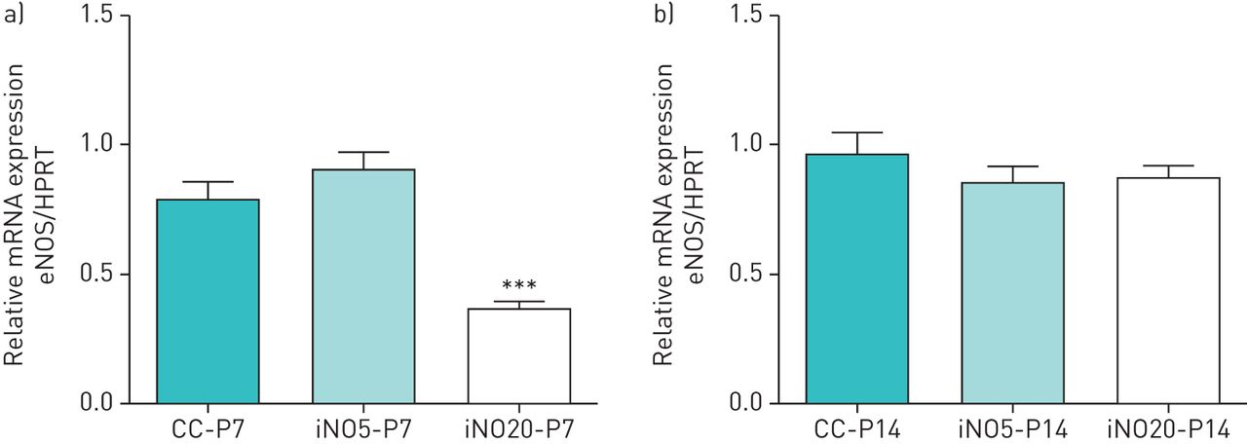
Quantification of endothelial nitric oxide synthase (eNOS) mRNA by quantitative reverse transcriptase (RT-PCR) in whole-lung homogenates at a) post-natal day (P) 7 and b) P14.
Thông Hua-Huy et al. ERJ Open Res 2016;2:00060-2015
©2016 by European Respiratory Society
Notes:
Quantification of endothelial nitric oxide synthase (eNOS) mRNA by quantitative reverse transcriptase (RT-PCR) in whole-lung homogenates at a) post-natal day (P) 7 and b) P14. Relative gene expression of eNOS in rat lungs was assessed by quantitative RT-PCR. Results were normalised to the amounts of hypoxanthine-guanine phosphoribosyltransferase (HPRT) mRNA. CC: rat pups kept in room air (control group); iNO5: rat pups kept in a Plexiglas chamber continuously filled with NO at 5 ppm (iNO-5 ppm group); iNO20: rat pups kept in a Plexiglas chamber continuously filled with NO at 20 ppm (iNO-20 ppm group). a) At P7, the amount of lung eNOS mRNA in the iNO-20 ppm group was significantly decreased as compared with that in the control group (p<0.005). b) At P14, the amounts of lung eNOS mRNA were comparable among the three groups of rat (p>0.05). ***: p<0.005 versus the control group (CC-P7).

